Slide 1
Blurring the Boundaries Between Clinical Trials and Healthcare Ecosystems
Christina Clise, PharmD Clinical Research Pharmacist
VA Cooperative Studies Program
Clinical Research Pharmacy Coordinating Center (CSP CRPCC) Albuquerque, New Mexico United States

Slide 5
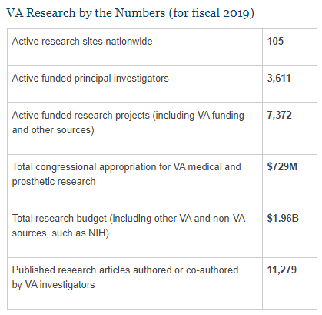
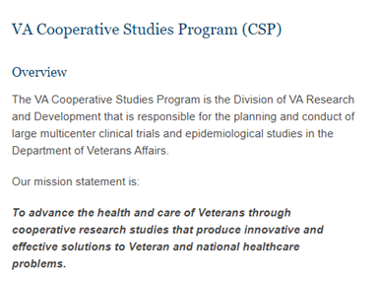

Slide 6
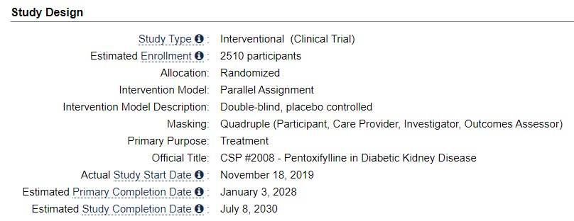

Slide 7
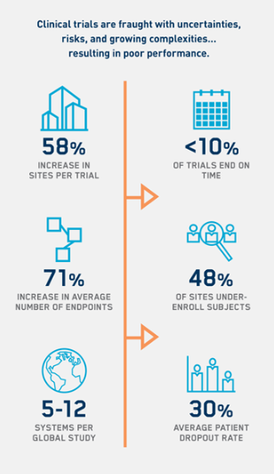
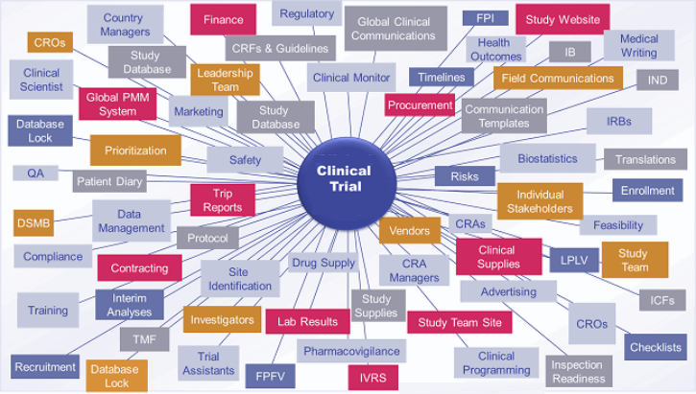

Slide 8
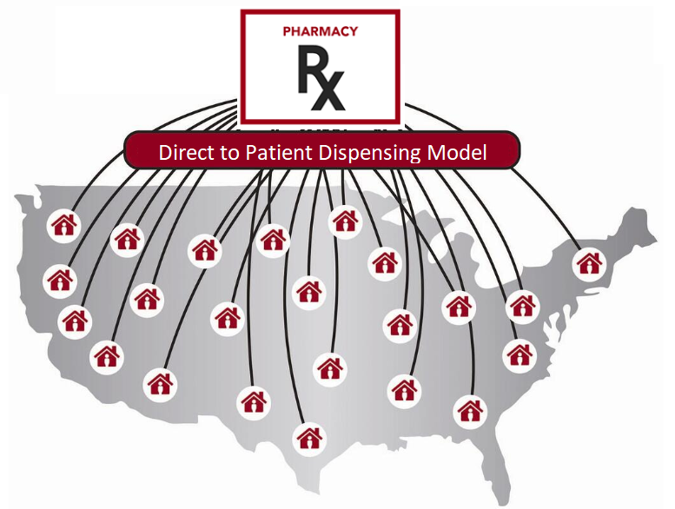
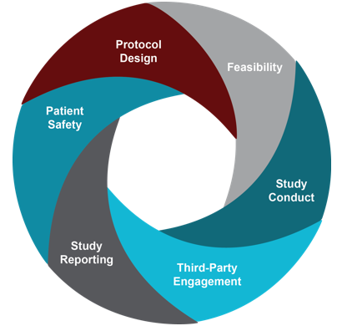
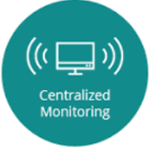
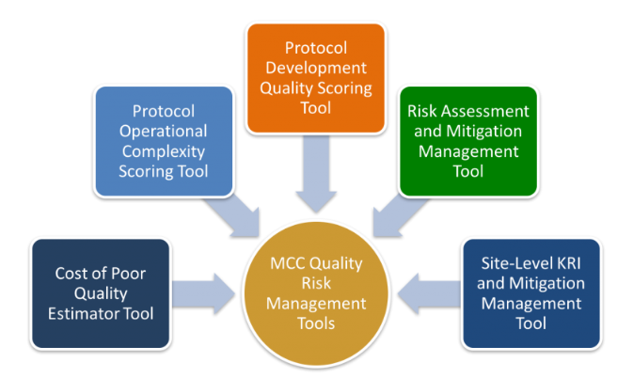

Slide 9
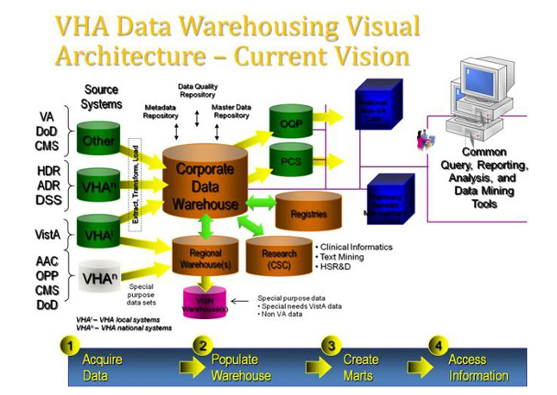

Slide 11
Study Design
Current Best Practice
Infrastructure and Operations

Slide 13
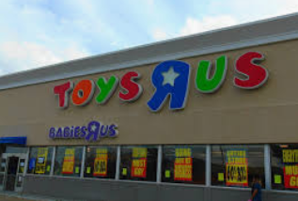
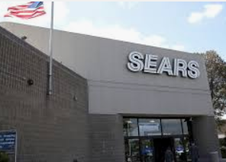
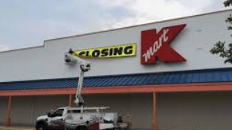

Slide 14
Christina E. Clise, PharmD.
Clinical Research Pharmacist
Clinical Research Pharmacy Coordinating Center - Albuquerque, NM
Office of Research & Development │Cooperative Studies Program
Department of Veterans Affairs
P: (505) 248-3203 F: (505) 248-3205
E: christina.clise@va.gov

